Slide 1
Chapter 5
Determination of Forward and Futures Prices

Slide 2
Consumption vs Investment Assets
Investment assets are assets held by significant numbers of people purely for investment purposes (Examples: gold, silver)
Consumption assets are assets held primarily for consumption (Examples: copper, oil)

Slide 3
Short Selling
Short selling involves selling securities you do not own
Your broker borrows the securities from another client and sells them in the market in the usual way

Slide 4
Short Selling (continued)
At some stage you must buy the securities so they can be replaced in the account of the client
You must pay dividends and other benefits the owner of the securities receives
There may be a small fee for borrowing the securities

Slide 5
Example
You short 100 shares when the price is $100 and close out the short position three months later when the price is $90
During the three months a dividend of $3 per share is paid
What is your profit?
What would be your loss if you had bought 100 shares?

Slide 6
Notation for Valuing Futures and Forward Contracts
S₀: | Spot price today
F₀: | Futures or forward price today
T: | Time until delivery date
r: | Risk-free interest rate for maturity T

Slide 7
An Arbitrage Opportunity?
Suppose that:
  The spot price of a non-dividend-paying stock is $40
  The 3-month forward price is $43
  The 3-month US$ interest rate is 5% per annum
Is there an arbitrage opportunity?
Notes:
18

Slide 8
Another Arbitrage Opportunity?
Suppose that:
  The spot price of non-dividend-paying stock is $40
  The 3-month forward price is US$39
  The 1-year US$ interest rate is 5% per annum (continuously compounded)
Is there an arbitrage opportunity?
Notes:
19

Slide 9
The Forward Price (equation 5.1)
If the spot price of an investment asset that provides no income is S₀ and the futures price for a contract deliverable in T years is F₀, then
F₀ = S₀e^{rT}
where r is the T-year risk-free rate of interest.
In our examples, S₀ =40, T=0.25, and r=0.05 so that
F₀ = 40e^{0.05×0.25} = 40.50
Notes:
20

Slide 10
If Short Sales Are Not Possible..
Formula still works for an investment asset because investors who hold the asset will sell it and buy forward contracts when the forward price is too low

Slide 11
When an Investment Asset Provides a Known Income (equation 5.2)
F₀ = (S₀ – I )e^{rT}
where I is the present value of the income during life of forward contract

Slide 12
When an Investment Asset Provides a Known Yield (equation 5.3)
F₀ = S₀ e^{(r–q )T}
where q is the average yield during the life of the contract (expressed with continuous compounding)

Slide 13
Valuing a Forward Contract
A forward contract is worth zero (except for bid-offer spread effects) when it is first negotiated
Later it may have a positive or negative value
Suppose that K is the delivery price and F₀ is the forward price for a contract that would be negotiated today

Slide 14
Valuing a Forward Contract
(equation 5.4)
By considering the difference between a contract with delivery price K and a contract with delivery price F₀ we can deduce that:
  the value of a long forward contract is (F₀ – K )e^{–rT}
  the value of a short forward contract is
(K – F₀ )e^{–rT}

Slide 15
Forward vs Futures Prices
When the maturity and asset price are the same, forward and futures prices are usually assumed to be equal. (Eurodollar futures are an exception)
In theory, when interest rates are uncertain, they are slightly different:
  A strong positive correlation between interest rates and the asset price implies the futures price is slightly higher than the forward price
  A strong negative correlation implies the reverse

Slide 16
Stock Index (equation 5.8)
Can be viewed as an investment asset paying a dividend yield
The futures price and spot price relationship is therefore
F₀ = S₀ e^{(r–q )T}
where q is the average dividend yield on the portfolio represented by the index during life of contract

Slide 17
Stock Index (continued)
For the formula to be true it is important that the index represent an investment asset
In other words, changes in the index must correspond to changes in the value of a tradable portfolio
The Nikkei index viewed as a dollar number does not represent an investment asset (See Business Snapshot 5.3)

Slide 18
Index Arbitrage
When F₀ > S₀e^{(r-q)T} an arbitrageur buys the stocks underlying the index and sells futures
When F₀ < S₀e^{(r-q)T} an arbitrageur buys futures and shorts or sells the stocks underlying the index

Slide 19
Index Arbitrage
(continued)
Index arbitrage involves simultaneous trades in futures and many different stocks
Very often a computer is used to generate the trades
Occasionally simultaneous trades are not possible and the theoretical no-arbitrage relationship between F₀ and S₀ does not hold (see Business Snapshot 5.4)

Slide 20
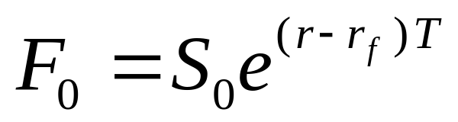
Futures and Forwards on Currencies (equation 5.9)
A foreign currency is analogous to a security providing a yield
The yield is the foreign risk-free interest rate
It follows that if r_{f} is the foreign risk-free interest rate

Slide 21
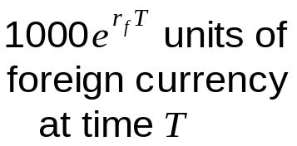
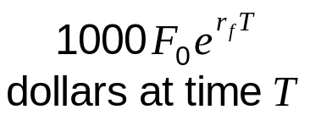
Explanation of the Relationship Between Spot and Forward (Figure 5.1)
1000 units of foreign currency (time zero)
1000S₀ dollars at time zero
1000S₀e^{rT}
dollars at time T

Slide 22
Consumption Assets: Storage is Negative Income (equations 5.11 and 5.12)
F₀ ≤ S₀ e^{(r+u )T}
where u is the storage cost per unit time as a percent of the asset value.
Alternatively,
F₀ ≤ (S₀+U )e^{rT}
where U is the present value of the storage costs.

Slide 23
The Cost of Carry (equation 5.19)
The cost of carry, c, is the storage cost plus the interest costs less the income earned
For an investment asset F₀ = S₀e^{cT}
For a consumption asset F₀ ≤ S₀e^{cT}
The convenience yield on the consumption asset, y, is defined so that F₀ = S₀ e^{(c–y )T}

Slide 24
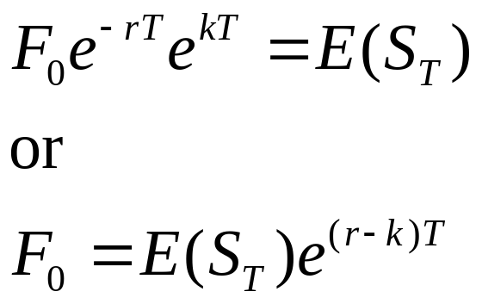
Futures Prices & Expected Future Spot Prices (equation 5.20)
Suppose k is the expected return required by investors in an asset
We can invest F₀e^{–r T} at the risk-free rate and enter into a long futures contract to create a cash inflow of S_{T} at maturity
This shows that

Slide 25
Futures Prices & Future Spot Prices (continued)
No Systematic Risk | k = r | F₀ = E(S_{T})
Positive Systematic Risk | k > r | F₀ < E(S_{T})
Negative Systematic Risk | k < r | F₀ > E(S_{T})
Positive systematic risk: stock indices
Negative systematic risk: gold (at least for some periods)

